Slide 1
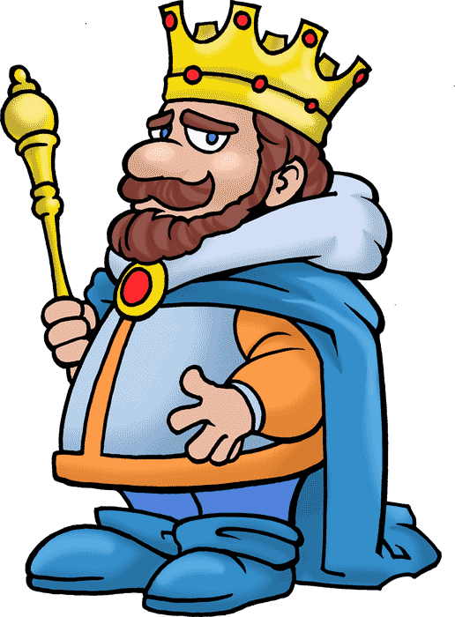
LEAR
W. Shakespeare
Anže Koderman in Anže G. Kralj , 9.a

Slide 3
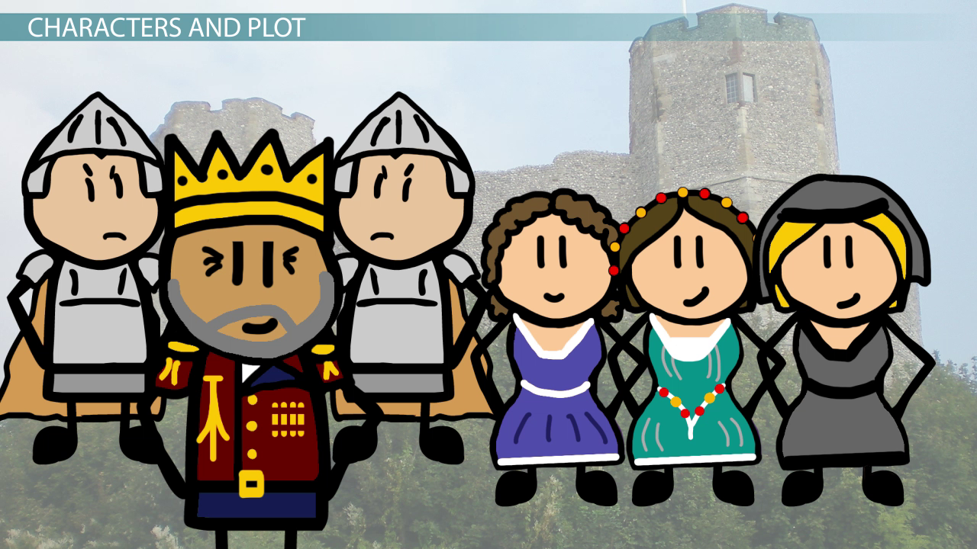
Cordelia Regan Goneril

Slide 6
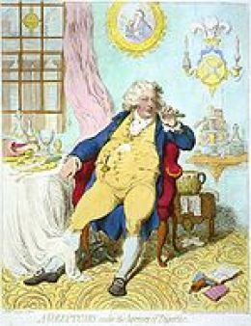

Slide 12
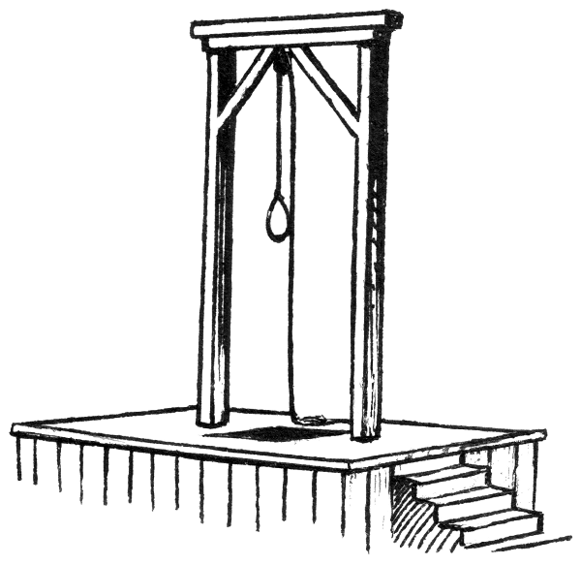
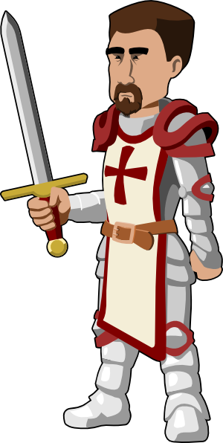

Slide 13
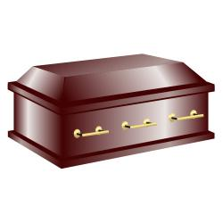

Slide 15
Viri
https://www.google.si/search?q=clipart&espv=2&source=lnms&tbm=isch&sa=X&ved=0ahUKEwi3g8jgttHSAhXMD8AKHR_CBIkQ_AUICCgB&biw=1366&bih=638
www.shutterstock.com

