Slide 1
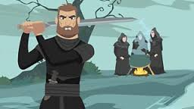
MACBETH
Nikolina Tomić in Uroš Tomić, 9.a

Slide 2
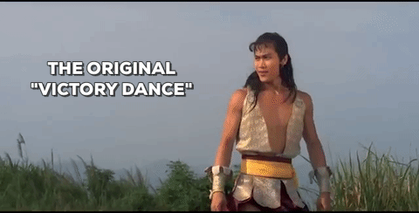

Slide 3
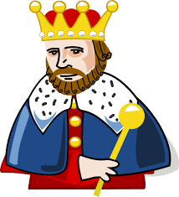

Slide 4
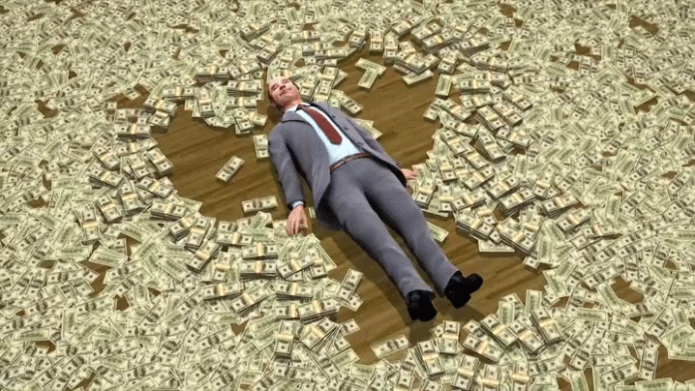

Slide 5
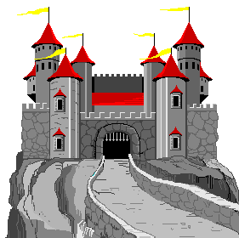

Slide 6
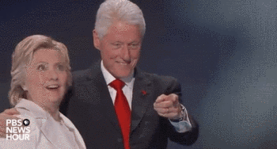
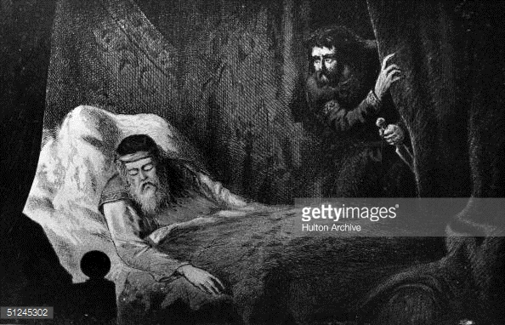

Slide 8
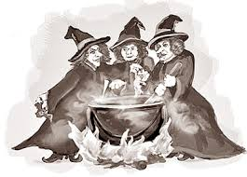

Slide 9
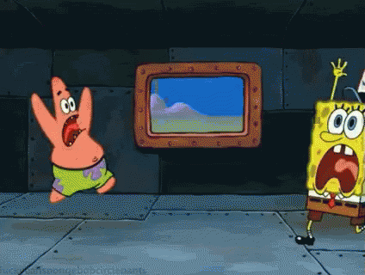

Slide 12
VIRI
www.bbc.co.uk/programmes/p03mmrng
https://www.slideshare.net/ShakespeareBT/macbeth-8234707
https://learnenglishteens.britishcouncil.org/uk.../shakespeare-macbeth

